Slide 1
The First Electronic Computers
Colossus and ENIAC
1942-1946

Slide 2
What constitutes a Computer?
Charles Babbage designed a mechanical computing machine called the Difference Engine in 1822.
His later concept for an Analytical Engine is considered the first general mechanical computer comprising a basic processing and storage of data.
Ada Lovelace published an algorithm for the machine and showed it could be programmed by punch cards.
Konrad Zuse designed the Z1 in the late 1930’s, an electro mechanical programmable computer.
The Harvard Mark 1 was a more sophisticated version which was first programmed by John von Neumann at the end of WWII.
The Colossus was the first fully programmable electronic computer.

Slide 3
Colossus and ENIAC
Colossus was the first fully programmable electronic computer.
It was invented and designed by Tommy Flowers and Alan Turing.
It made a major contribution to ending World War II when it helped to crack the codes of Nazi encryption machines.
Simultaneously in the USA, Eckert and Mauchly built the ENIAC (Electronic Numerical Integrator and Computer) which is often considered to be the first example of a general purpose digital computer.

Slide 4
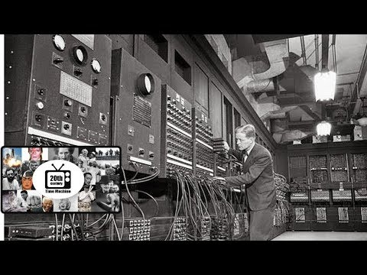

Slide 5
Components of first programmable computers
The first electronic computers, Colossus and ENIAC, weighed tonnes, occupied large rooms and before the invention of semiconducting transistors, switching was executed by vacuum tubes.
Military advances during WWII spurred innovation and fast tracked the invention of ENIAC.
The Colossus was rebuilt in Bletchley Park, the top secret British site of WWII decryption.
The Babbage analytical machine had 4 revolutionary features - input, storage, processing and output components.
Sequential flow control and looping operations were fundamental to his concept. Today, the inside of modern computers are not that different.

Slide 6
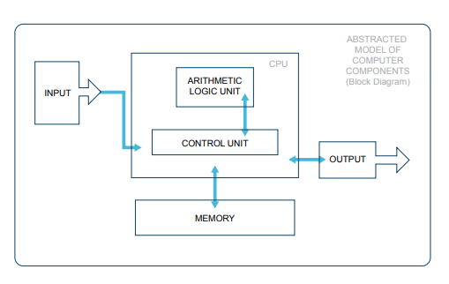
The Arithmetic Logic Unit (ALU) where instructions are actually carried out is probably the only functional unit that is extra to the original concept.

Slide 7
The complex relationship between society and computing technology is demonstrated clearly through the invention of the Colossus and ENIAC.
The Colossus had a real impact on the war, shortening it by 2 or 3 years. (https://www.bbc.com/news/technology-18419691)
Processing data, encrypting and deciphering codes and crunching numbers became key factors in deciding the outcome of WWII.
Many military innovations become mainstream technologies. The US Defence Advanced Research Projects Agency (DARPA) developed the Arpanet in the late 1960’s. It connected 4 nodes in the USA, developed IP addresses and invented TCP and UDP networking protocols. In the 1980’ s it evolved into the Internet.

Slide 8

DARPA

Slide 9
Positive and negative impacts of military innovations on society and on technology
Homework:
Write your thoughts on the positive and negative impacts of military innovations on society and technology. (10 sentences)
Do you think that the positives have outweighed the negatives and why?

Slide 10
Military innovations, including wartime inventions, have an overall positive impact on society and technology
________________________________________________________________________________________________________________________
Societies advance rapidly, from a technological point of view, when there is a strong military and especially during wartime.
_________________________________________________________________________________________________________________________

Slide 11
Group Assignment
Military innovations, including wartime inventions, have an overall positive impact on society and technology
Military innovations, including wartime inventions, have an overall negative impact on society and technology
Societies advance rapidly, from a technological point of view, when there is a strong military and especially during wartime.
Societies advance slowly or not at all, from a technological point of view, when there is a weak military or no military at all.

